Slide 1
Unit - II
Field Programmable Gate Array, Hardware Description Language

Slide 2
CONTENTS
Transistor as a Switch,
Characteristics of Digital ICs, DL, RTL, DTL, TTL, ECL, IIL,
Characteristics and uses of MOSFET (CS, Common drain and Common gate),
MOSFET Logic, PMOS,NMOS, CMOS Logic,
Propagation delay,
Tristate Logic, Tristate Logic Applications,
FPGA Basics,
Introduction to HDL and logic simulation,
HDL System primitives,
user defined primitives,
Stimulus to the design,

Slide 3
FPGA
A Field-Programmable Gate Array (FPGA) is an integrated circuit that can be configured by the user to emulate any digital circuit as long as there are enough resources.
The FPGA configuration is generally specified using a hardware description language (HDL)
An FPGA can be seen as an array of Configurable Logic Blocks (CLBs) connected through programmable interconnect (Switch Boxes).
*
‹#›

Slide 4
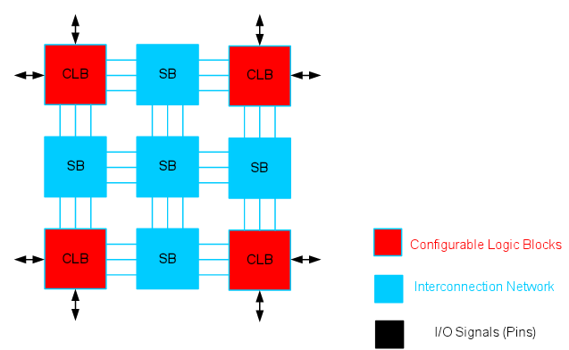
FPGA structure

Slide 5
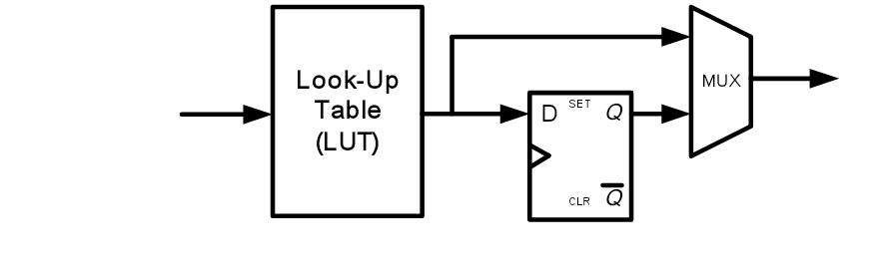

Simplified CLB Structure

Slide 6
Hardware Description Language - Introduction
HDL is a language that describes the hardware of digital systems in a textual form.
It resembles a programming language, but is specifically oriented to describing hardware structures and behaviors.
The main difference with the traditional programming languages is HDL’s representation of extensive parallel operations whereas traditional ones represents mostly serial operations.
The most common use of a HDL is to provide an alternative to schematics.

Slide 7
HDL – Introduction
When a language is used for the above purpose (i.e. to provide an alternative to schematics), it is referred to as a structural description in which the language describes an interconnection of components.
Such a structural description can be used as input to logic simulation just as a schematic is used.
Models for each of the primitive components are required.
If an HDL is used, then these models can also be written in the HDL providing a more uniform, portable representation for simulation input.

Slide 8
HDL – Introduction
HDL can be used to represent logic diagrams, Boolean expressions, and other more complex digital circuits.
Thus, in top down design, a very high-level description of a entire system can be precisely specified using an HDL.
This high-level description can then be refined and partitioned into lower-level descriptions as a part of the design process.

Slide 9
HDL – Introduction
As a documentation language, HDL is used to represent and document digital systems in a form that can be read by both humans and computers and is suitable as an exchange language between designers.
The language content can be stored and retrieved easily and processed by computer software in an efficient manner.
There are two applications of HDL processing: Simulation and Synthesis

Slide 10
Logic Simulation
A simulator interprets the HDL description and produces a readable output, such as a timing diagram, that predicts how the hardware will behave before its is actually fabricated.
Simulation allows the detection of functional errors in a design without having to physically create the circuit.

Slide 11
Logic Simulation
The stimulus that tests the functionality of the design is called a test bench.
To simulate a digital system
Design is first described in HDL
Verified by simulating the design and checking it with a test bench which is also written in HDL.

Slide 12
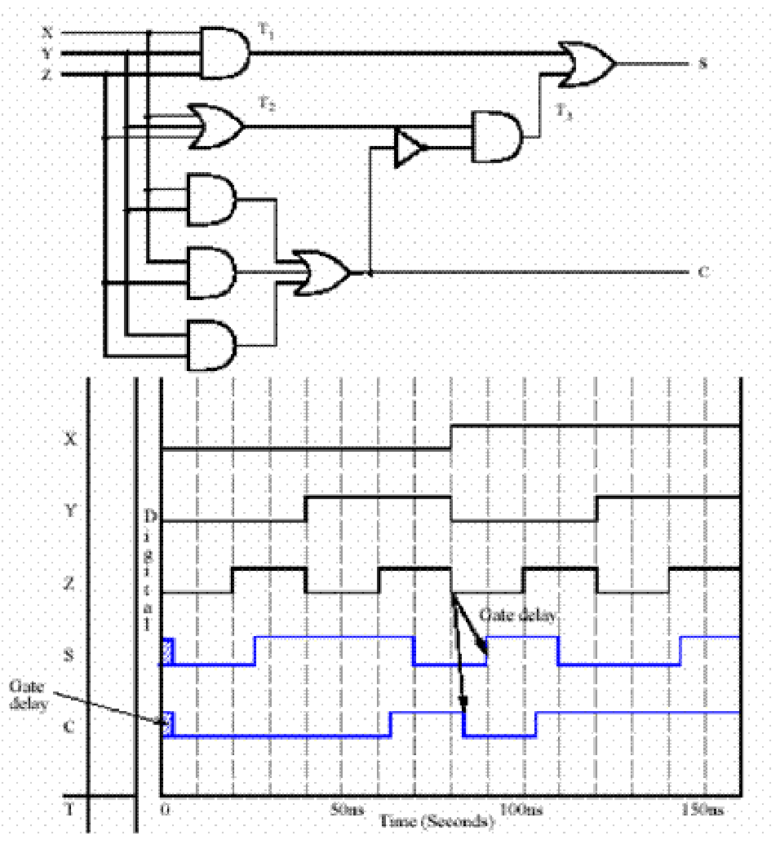
Logic Simulation
Logic simulation is a fast, accurate method of analyzing a circuit to see its waveforms

Slide 13
Types of HDL
There are two standard HDL’s that are supported by IEEE.
VHDL (Very-High-Speed Integrated Circuits Hardware Description Language) - Sometimes referred to as VHSIC HDL, this was developed from an initiative by US. Dept. of Defense.
Verilog HDL – developed by Cadence Data systems and later transferred to a consortium called Open Verilog International (OVI).

Slide 14
Verilog
Verilog HDL has a syntax that describes precisely the legal constructs that can be used in the language.
It uses about 100 keywords pre-defined, lowercase, identifiers that define the language constructs.
Example of keywords: module, endmodule, input, output wire, and, or, not , etc.,
Any text between two slashes (//) and the end of line is interpreted as a comment.
Blank spaces are ignored and names are case sensitive.

Slide 15
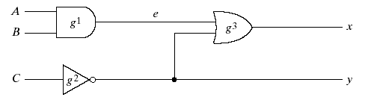
Verilog Module
A module is the building block in Verilog.
It is declared by the keyword module and is always terminated by the keyword endmodule.
Each statement is terminated with a semicolon, but there is no semi-colon after endmodule.

Slide 16
Verilog Module for simple circuit
HDL Example
module smpl_circuit(A,B,C,x,y);
input A,B,C;
output x,y;
wire e;
and g1(e,A,B);
not g2(y,C);
or g3(x,e,y);
endmodule

Slide 17
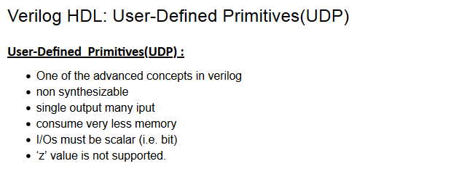
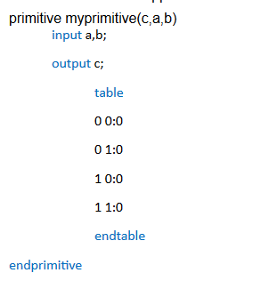
HDL user defined primitives

Slide 18
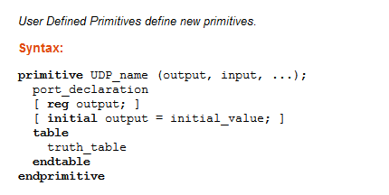
HDL user defined primitives

Slide 19
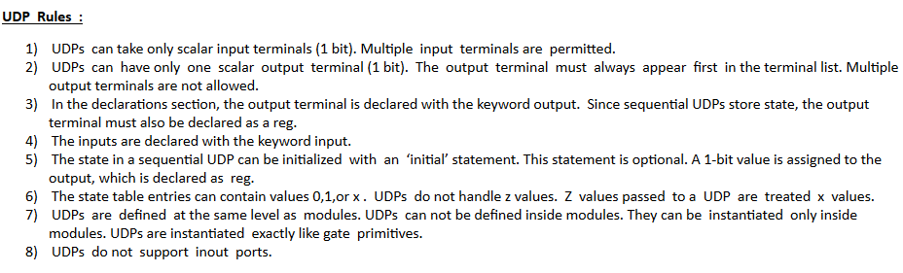
HDL user defined primitives

Slide 20
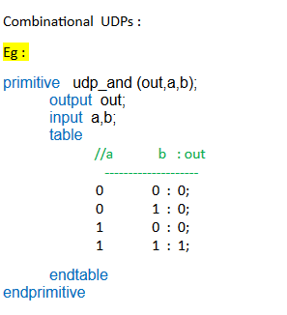
HDL user defined primitives

Slide 21
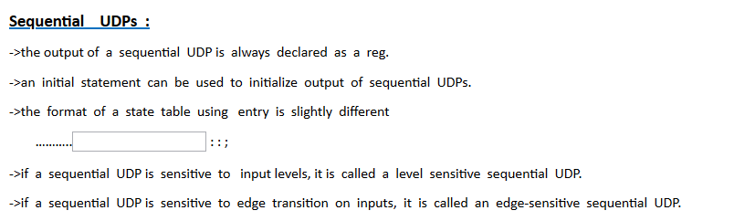
HDL user defined primitives

Slide 22
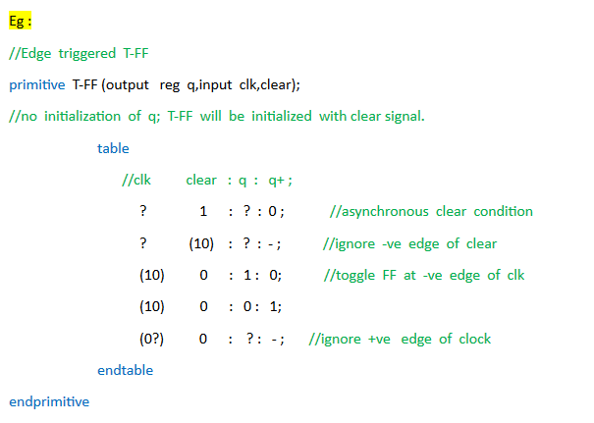
Sequential Level Sensitive UDP’s example

Slide 23
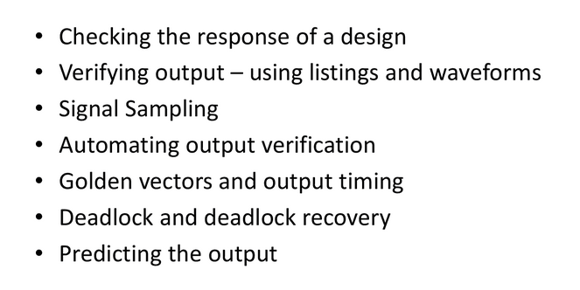
Stimulus to the design

Slide 24
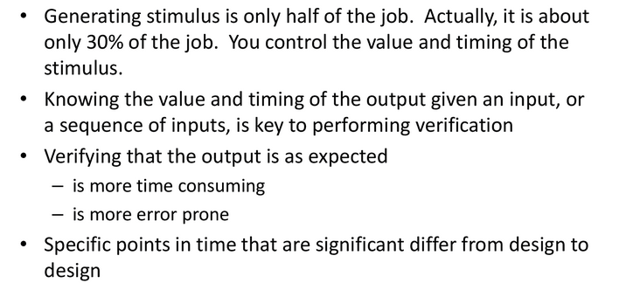
VERIFYING OUTPUT

